Slide 1



Superstore Analytics by Year
View in Power BI
Last data refresh:
05/10/2023 14:23:11 UTC
Downloaded at:
05/10/2023 14:34:42 UTC

Slide 2
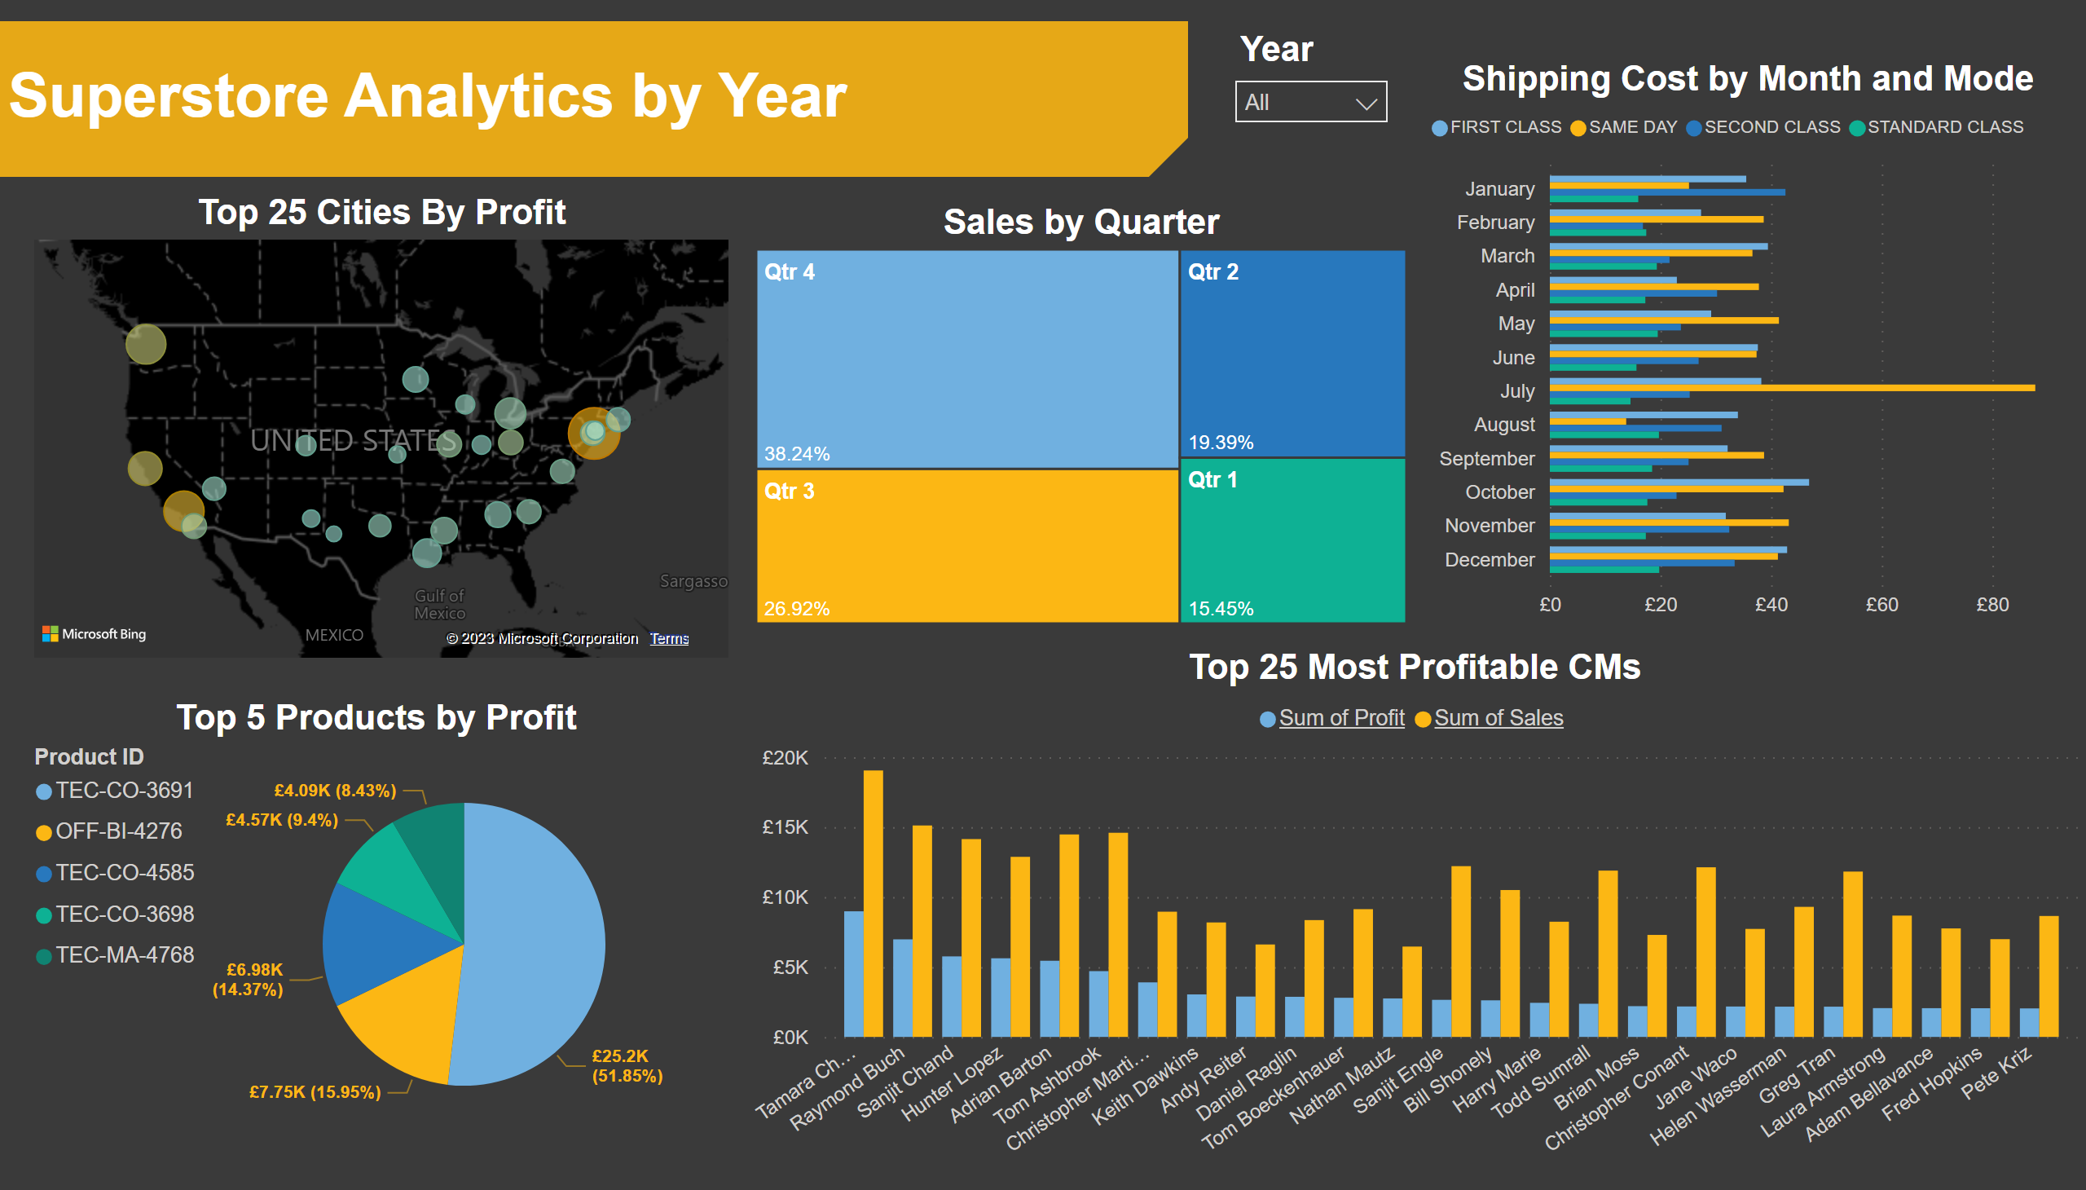
Tops
Notes:
Top 25 Cities By Profit
No alt text provided
shape
No alt text provided
Sales by Quarter
No alt text provided
Top 25 Most Profitable CMs
No alt text provided
Top 5 Products by Profit
No alt text provided
Shipping Cost by Month and Mode
No alt text provided
textbox
No alt text provided
slicer
No alt text provided

